Slide 1
Fostering the political will through successful advocacy
Lars Strömgren
2018-12-13

Slide 2
The challenges while promoting cycling
To make cycling more attractive and increase the number of cyclists in the CB region our efforts needs to be consolidated. There is a need to involve citizens and other sectors in the planning process to reach a holistic approach.
Initiatives that aim to promote cycling in cities are often fragmented and full of gaps and thus have low impact. Old organizational structures within the city administrations are traditionally not used to working with cycling planning. In comparison with infrastructure for cars the investments are also small and the projects not prestigious enough to gather interest and reach the very top of the political agenda.
The fact that cycling can benefit society in a variety of ways including increased public health, inclusion, lower carbon emissions and safety can also contribute to scattered responsibility on several different stakeholders. The elements of society which gain from the benefits are not always the ones responsible for investments in safe and convenient infrastructure.
To consolidate the efforts on promoting healthy urban planning for cycling as means of transport we need to identify existing efforts as well as stakeholders who are or should be interested in contributing.
#biking4health
www.heatproject.eu
#planningtogether

Slide 3
Is your city ready for healthy urban planning?
Is your city ready to implement cycling measures to contribute to healthier, more active and inclusive urban areas, in which cycling is a safe, popular and accepted mode of transport?
Or, your city is not yet ready and doesn’t understand, in which case we need to influence them.
#biking4health
www.heatproject.eu
#planningtogether

Slide 4
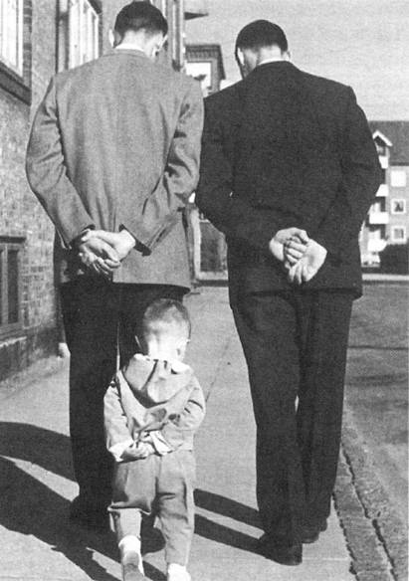
Advocacy: introduction
At Cykelfrämjandet we encourage cycling advocates to ask themselves questions about how policy change happens and which policy ideas are successful and sweep through society like great waves. Cykelfrämjandet also studies how other industries and other sectors achieve this. This process is called advocacy or lobbying.
It does not matter whether it is internal lobbying by staff members to influence political decisions or budgets or how things work; or whether it is understanding the big external waves in society.
#biking4health
www.heatproject.eu
#planningtogether

Slide 5
How to influence your decision makers
Talking to your boss
Lobbying
Media monitoring and influencing
Organizing political groups
Collecting data
Project planning
Hold a consultation
Activating your stakeholders
Organize workshops/events
Including projects in your budgets
#biking4health
www.heatproject.eu
#planningtogether

Slide 6
What is ‘advocacy’?
Advocacy is a political process by an individual or a large group which normally aims to influence public-policy and resource allocation decisions within political, economic, and social systems and institutions. http://en.wikipedia.org/wiki/Advocacy
It does not matter whether it is internal lobbying by staff members to influence political decisions or budgets or how things work; or whether it is understanding the big external waves in society.
#biking4health
www.heatproject.eu
#planningtogether

Slide 7
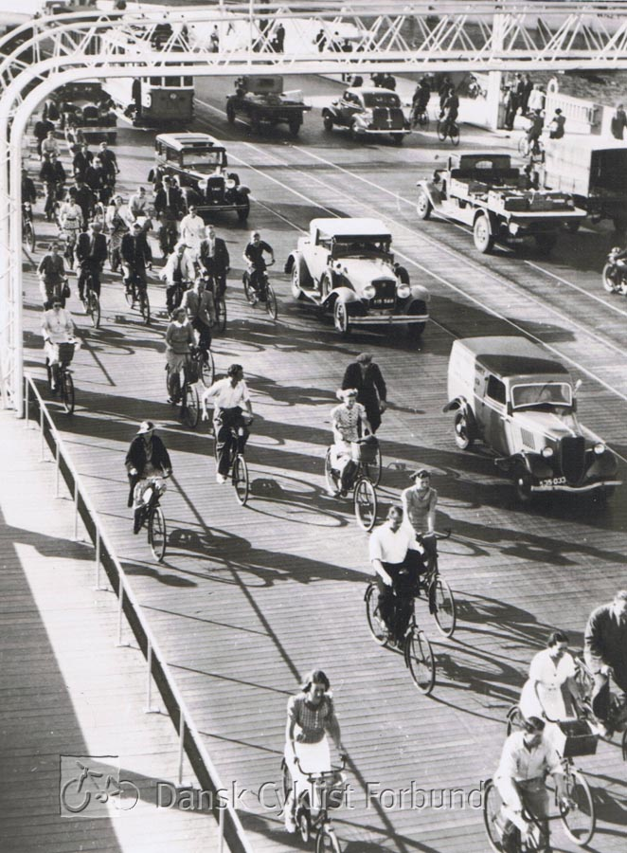
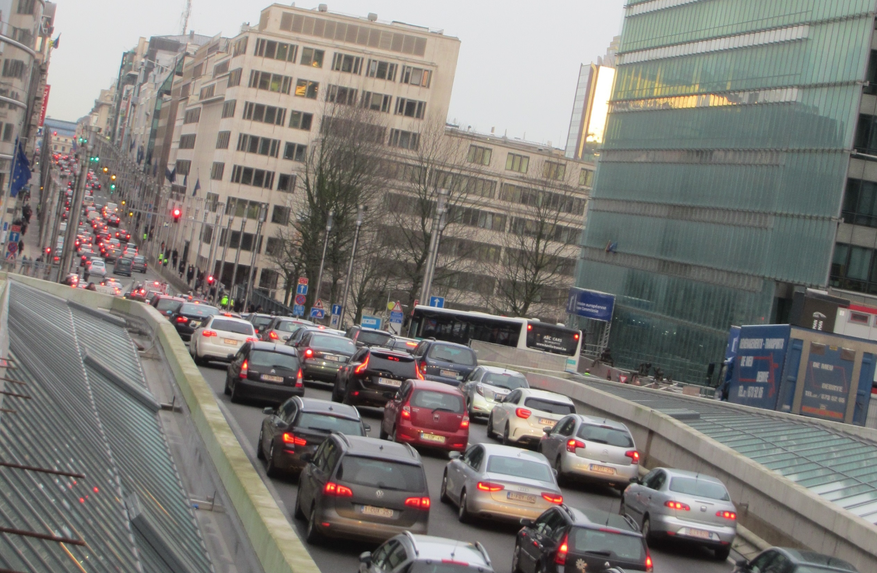
How did we go from this…
Cities are constantly evolving.
Who influenced the change? Who made the change? And why did it happen?
…to this?
#biking4health
www.heatproject.eu
#planningtogether

Slide 8
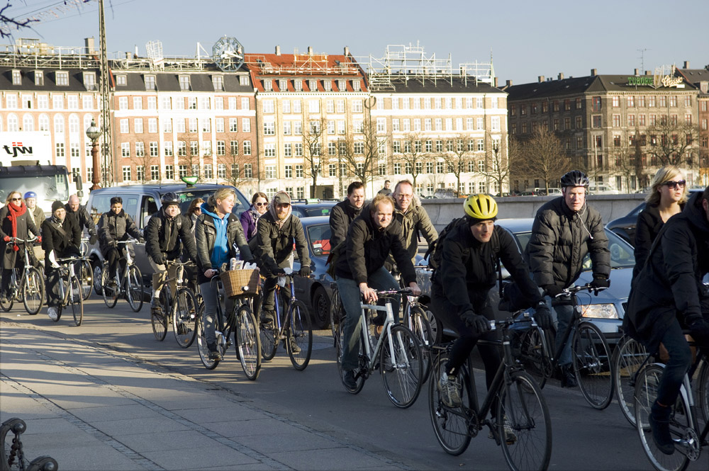
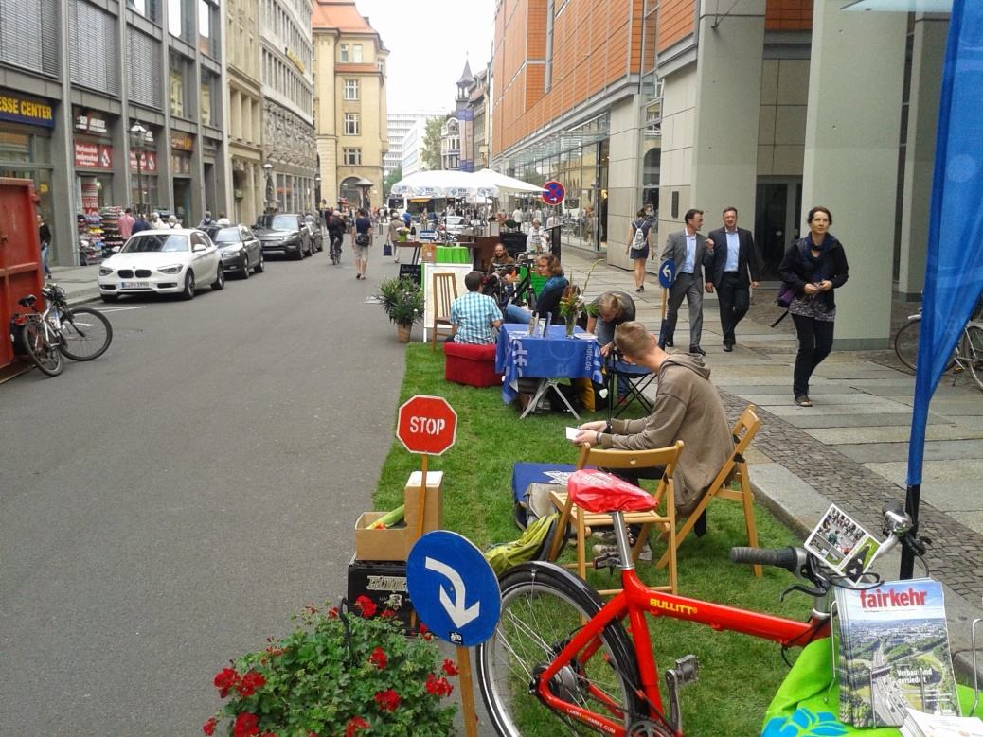
Good news: Alternatives do exist
After 40 years of turning the tide, we can see that there are places where alternatives exist.
We can see that cycling measures can be implemented in cities to contribute to healthier, more active and inclusive urban areas where cycling is a safe, popular and attractive mode of transport.
#biking4health
www.heatproject.eu
#planningtogether

Slide 9
It’s about the “how”
Research shows that policies which are most likely to be adopted have the following ingredients in common:
Problem: A recognised, shared, public issue that public bodies should address
Policy solution: proposals/actions that can be delivered, i.e. affordable and timely
Political will: key influencers, political intentions, implicit political desire, personal endorsement
Problem
Policy Solution
Political Will
#biking4health
www.heatproject.eu
#planningtogether

Slide 10
1. Recognizing the common problem
First, there should be an actual problem to be solved by the public sector; there has to be a perceived need for action. This pressure to act can be because of public opinion or the media, or it can be an existential threat to health such as poor air quality, or a refugee crisis. The bigger the perception, the more likely it is that people will search for a solution.
Example of a ‘common’ problem:
Politicians and the public opinion are currently more concerned with air quality than with inactivity. Therefore air quality has become a ‘common problem’ shared between society and governments that has to be resolved. Inactivity is maybe a bigger problem, but at the moment, it is not a shared (common) focus.
Example of where the problem is not a priority and therefore not ‘common’:
Climate change is a big issue, but the public opinion tends to be more focused on migration, economic crisis, etc.
#biking4health
www.heatproject.eu
#planningtogether

Slide 11
2. Identifying deliverable policy solutions
Second, there must be a viable policy solution available. Sometimes a policy solution might not be available now:
Some issues are so big and overwhelming they are not in the political sphere of influence, such as a local decision maker.
Decision makers don’t have the budget or the influence on the specific topic under discussion.
Maybe you would like to see a major budget change. It might just not be the right time if you are in a situation where the budget is fixed for the next two years.
It must be possible for a policy solution to be delivered and that policy solution must be practical.
For example: If you want to build a bike lane, you should know how much it will cost, where the funds will come from, the most effective place to put it, and you should do the research to measure the effect on congestion and health as well as the wider economic, social and environmental impacts.
#biking4health
www.heatproject.eu
#planningtogether

Slide 12
3. Fostering political will
Finally, you have to have your political framework in place. It might be the case that politicians are not listening or it might be that when it comes to discussion, you don’t have your stakeholder alliance in place. In that case you might hit barriers that are impossible to overcome. Sometimes these barriers are not expressed or understood. You need to have this third dimension.
Example of political will:
The mayor is on your side and she/he is convinced by the solution you are offering.
Example of lack of political will:
Politicians who create political barriers because they argue for road building or very expensive extensions to public transport solutions, even though you have a very practical and low-cost solution readily available.
Politicians who do not acknowledge the root of a problem and/or do not make progressive decisions for fear of not getting re-elected.
#biking4health
www.heatproject.eu
#planningtogether

Slide 13
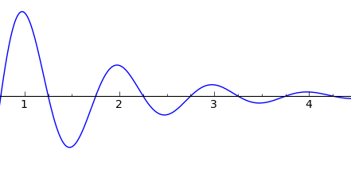
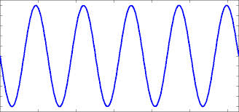
Kingdon’s Policy Windows
Interestingly, the problem is often related to timing, which is what Kingdon studied and described as “policy windows”.
Why do some fantastic policies not happen? Why do some equally unexpected policies suddenly become a top priority?
Kingdon visualised these three conditions (problems, proposals and politics) as waves going through time. In each of the three waves, things change.
Sometimes you don’t have a solution ready. Sometimes it’s just not the time. Sometimes you don’t have a budget process open. Other times public opinion fades so while you thought you were the most important topic of the moment, something else came up.
#biking4health
www.heatproject.eu
#planningtogether

Slide 14
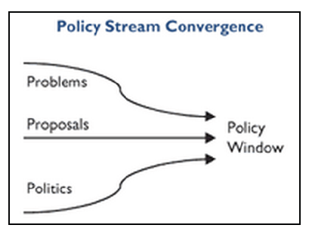
Kingdon’s Policy Windows
Kingdon tells us that the strongest policy implementations are when the three layers actually converge.
If you want to have maximum impact, you should not work in one dimension but in all three dimensions. You have to ask yourself the following questions:
Do I have the right solution in time?
Or if there is a point in the future, for example when an election is coming up and campaigning about fixing the city become a really popular topic for discussion, do I, as a public servant, have the solution or the budget ready to offer? So, there is a window of opportunity when these waves converge. This can happen now or in the future. Or a window of opportunity you will help to create because you are influencing it.
#biking4health
www.heatproject.eu
#planningtogether

Slide 15
Summary of successful advocacy
So to recap, policies that are most likely to be adopted have the following in common:
Problem: A recognised, shared, public issue that public bodies should address
Policy solution: proposals/actions that can be delivered, i.e. affordable and timely
Political will: key influencers, political intentions, implicit political desire, personal endorsement
What research tells us, is that if we don’t have at least 2 of these 3 conditions (Problem, Policy solutions and Political will) in place, policies will not take root. They do not become adopted.
#biking4health
www.heatproject.eu
#planningtogether

Slide 16
Conclusion - advocacy
You have learned about how to review the decision making and political context in your city.
Questions to ask yourself:
Is there – in my city, my region, my country – a recognised and shared conclusion that congestion/bad air quality/inactivity is a problem and has to be fixed?
Which problem is considered to be the most ‘common’ problem? Meaning the problem politicians and the public opinion are currently more concerned with.
What kind of pressure is on the political system to address this problem? It might be that this is not the case.
Can I deliver a policy solution that is practical and easy to implement? Can I demonstrate the positive effects of cycling measures in my city? Do I have a proposal that is available and deliverable? What can the HEAT project offer to strengthen my case?
Is the political community, in which I am working, behind me? Am I building political consensus? Are my networks supportive and well-informed? Do I have enough hard facts to present to decision makers and build political support?
#biking4health
www.heatproject.eu
#planningtogether

Slide 17
Who are the actual decision makers?
In order to identify and encourage political will you need to know with whom you are dealing.
One useful tool when trying to identify the key influencers and having them working for your cause is is stakeholder mapping.
We will also focus on influence mapping, where you will learn about the lines and the relations towards the key influencer.
It can also be interesting to consider ongoing initiatives in the planning fields as influencers themselves as well as NGOs and the general public. This will get you ready to approach the right stakeholders!
#biking4health
www.heatproject.eu
#planningtogether

Slide 18
Stakeholder mapping: introduction
Stakeholder mapping is a tool that comes out of project management: to find out who could influence the success of a project. It is about understanding who the internal customers are, but also, who are the people that don’t have much influence but are interested in the success of the project or aim.
Stakeholder mapping has been adapted for NGO’s, political lobbying and creating change, because it is a great way of expressing the change you want to see and identifying who matters when it comes to that change.
In this material we will show two variations of stakeholder mapping:
Classic stakeholder mapping
Method to target individuals: influence mapping
Tips/Tricks
In an individual campaign or policy work, a stakeholder map is one of the most powerful tools.
#biking4health
www.heatproject.eu
#planningtogether

Slide 19
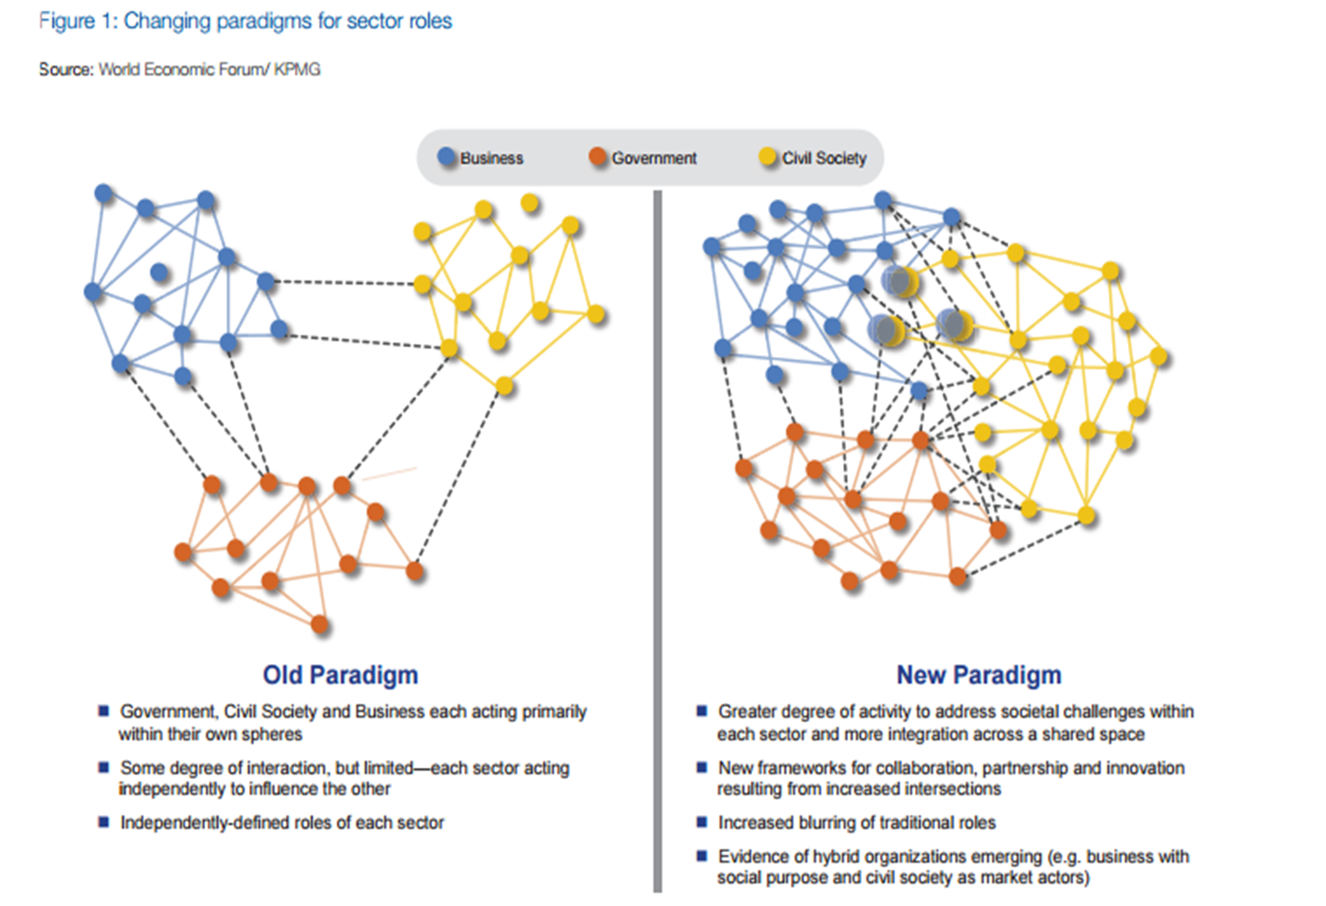
Stakeholder mapping: a shift in relations
Here you can see a reflection of the changing world in which we operate.
The historic paradigm (left) shows that the different groups are in one niche or corner of society: the civil society, business and governments. It is getting more blurry than that (right). Businesses also take on a responsibility for society rather than just making profit. Governments realize that they need to engage stakeholders in a different way and work more with partnerships. If you want to create a change, you need to be closer to the stakeholder that have the power to change, that have the influence.
The questions is: which relations work? Which relations costs a lot of time but don’t trigger the change? With stakeholder mapping, you can plan the relations to put time in strategically.
#biking4health
www.heatproject.eu
#planningtogether

Slide 20
Actor-Network Theory and stakeholders
Actor-Network Theory (ANT) was developed by sociologists in France in the 1980s as an attempt to understand the processes of innovation and knowledge-creation in science and engineering fields.
Alongside individuals and organizations, one can consider ongoing initiatives and processes influencing outcomes.
health
policy
planners
traffic users
culture
climate
cyclists
existing infra-structure
drivers
#biking4health
www.heatproject.eu
#planningtogether

Slide 21
Different roles of stakeholders
You can map your different stakeholders on a grid, based on their different roles in the process.
There are two different axes:
Influence or power: when you lobby, you obviously are interested in the people who have the power to make a difference on this decisions. That might be the number one decision maker who is right at the top right corner, but there are other people who can influence as well.
The interest in the topic: there can be highly powerful and influential people who have no interest in the topic at all. And there can also be people who are highly passionate, but have no influence. So you need to know what their interest in the topic is to map them.
This tool is used to map where people are in the process and map them against the axes. If that is clear, you also start to think about how to interact with the stakeholders once you know in which part of the grid they belong.
High influence, low interest
High influence, high interest
Add picture here
Influence or power
Low influence, low interest
Low influence, high interest
Interest
#biking4health
www.heatproject.eu
#planningtogether

Slide 22
Different roles of stakeholders
Important to note is that you have to start with influence or power, ask yourself the question: who can influence this particular goal? Do not start with just looking at your allies, who are already interested but might have no power. Look more outside of the box.
High influence, low interest
High influence, high interest
Add picture here
Influence or power
Low influence, low interest
Low influence, high interest
Interest
Tips/Tricks
Always focus on the stakeholders with the power and influence to change first, try to think of ways how you can gain their interest.
#biking4health
www.heatproject.eu
#planningtogether

Slide 23
How to approach the stakeholders: change!
Brainstorm to determine where the different stakeholders are at the moment and how to approach them.
It can be the case that there are almost no stakeholders in the top right box. We however have the power to move people and move the position of the stakeholders.
Move number 1: find an influential stakeholder in the top left box and try to grab the interest of the stakeholder for your subject. Figure out where they are interested in and use that. Or find out if they want to influence other people in the top right box: can you make a deal? (introduce someone to a key player if that persons supports your story)
Move number 2: it is also possible that there are stakeholders in the bottom right box that can become influential (change of jobs, you discover that they play golf with the decision maker, etc.). That is why you should keep a good relationship with the stakeholders in that box.
Meet their needs
Key player
Influence or power
Least important
Show consideration
Interest
#biking4health
www.heatproject.eu
#planningtogether
Notes:
Target groups are the urban planners, the city administration, city officials, inhabitants, the regional public authorities or companies.

Slide 24
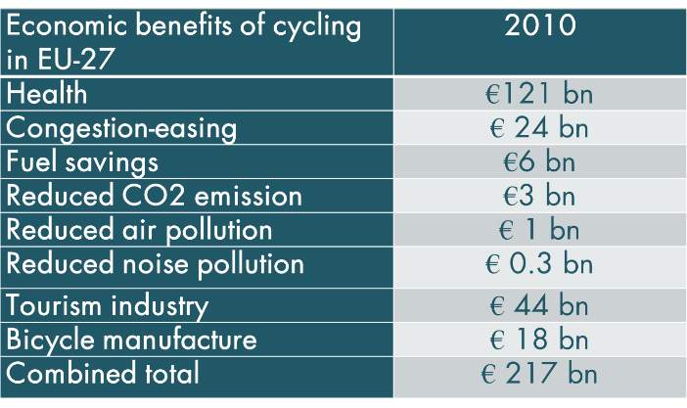
How to approach the stakeholders: example
At the European Cyclists’ Federation, we used to focus on other topics, but when the Juncker commission came into power in the European Union, we completely reset our focus on jobs and job growth. If your work didn’t have job story, you were not in the action.
We focused on jobs because that is what they wanted to hear and that moved them from the non-interested box to the interested box.
We also added the economic dimension, because it was about showing where the money is and where the money would go.
Any physical activity organization should be able to show these numbers which makes you able to go and talk to stakeholders who care about the money. You have got to make yourself interested by showing a cost-benefit analysis.
#biking4health
www.heatproject.eu
#planningtogether

Slide 25
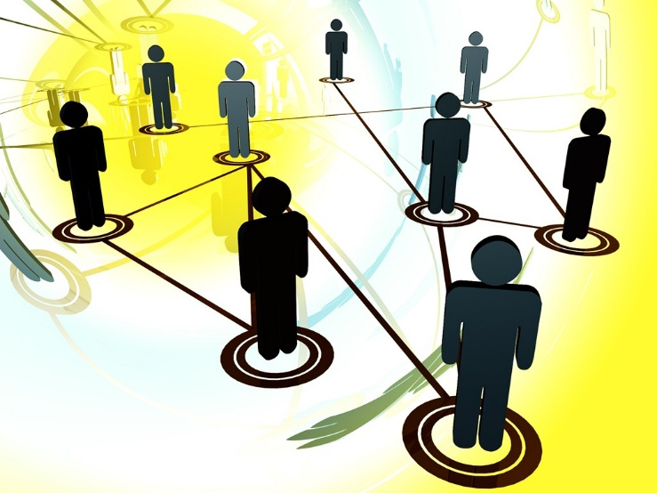
Wrap up of stakeholder mapping
What stakeholder mapping does is to help you to position your energy: working mostly with the people who can make the change and who have the influence. But it also helps you to think about how you should deal and communicate with the other stakeholders. It makes sure you are aware on how you should deal with your stakeholders.
If you want to build a coalition on public health for instance, you would definitely work with the group in the upper right corner of the grid. What stakeholder mapping tells you is:
What movements should be made if the upper right corner is not rich enough?
Who do you need to bring in to make the change?
What arguments might they listen to?
What is the right moment to make that progression?
Tips/Tricks
Combine stakeholder mapping with the right policy windows, always focus on the right timing when approaching the person that has the influence.
In an individual campaign or policy work, a stakeholder map is one of the most powerful tools.
#biking4health
www.heatproject.eu
#planningtogether

Slide 26
Actor-Network Theory and stakeholders
Alongside individuals and organizations, one can consider ongoing initiatives and processes influencing outcomes.
It can be useful for to understand and visualize the context of organizations, processes, and technologies affecting processes.
Brainstorm to determine where the different stakeholders are at the moment and what policies, context, culture and climate are affecting them.
health
policy
planners
traffic users
culture
climate
cyclists
existing infra-structure
drivers
#biking4health
www.heatproject.eu
#planningtogether

Slide 27
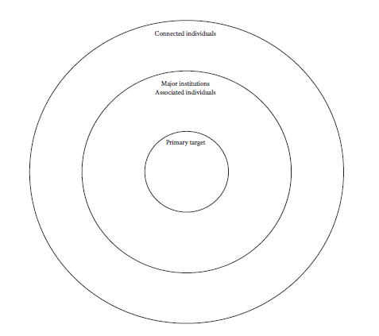
Another tool: influence mapping
There is a variation on the classic stakeholder mapping tool. This is not always necessary to use, but is often used when people get stuck when they want to go to the delivery phase. It is called influence mapping.
The key of influence mapping is that it forces you to understand who will make the decision.
Tips/Tricks
Another way of mapping stakeholders is influence mapping, this has a clear focus on the individual or party that has the influence and the direct lines towards that person.
#biking4health
www.heatproject.eu
#planningtogether

Slide 28
Influence mapping: the decision maker
In the middle of the circle you always put the person or committee that can make the decision for change (primary target). Everything can be in place and there might be a lot of energy for change, but if you never reach that person, the change will not be made.
Decision maker
#biking4health
www.heatproject.eu
#planningtogether

Slide 29
Influence mapping: the connection to the decision maker
The second ring (major institutions, associated individuals) are the people that know the primary target, the people that the primary target cares about. Who influences the decision of the primary target? Who speaks to them? That can be as narrow as one person, the policy advisor for instance. It could also be a political party, trade unions, but even friends and family.
The only people allowed in this second circle are people that have actual contact with the decision maker, with the primary target. It is almost down to individuals. If you don’t have a person that connects to the decision maker, you have a problem.
Decision maker
#biking4health
www.heatproject.eu
#planningtogether

Slide 30
Influence mapping: the connected individuals
The outer circle is the connected society: it is the interest group. You can draw the stakeholders who are in the interest group from your stakeholder map.
Interest group
#biking4health
www.heatproject.eu
#planningtogether

Slide 31
Influence mapping: drawing the dots
The key thing about influence mapping is drawing the dots in the map. An example: there can be a person (A), whose children go to school with the children of person B and they see each other socially in the weekend. You need to find the right connections.
If you are really lucky, there might even be a connection from the outer circle directly to the decision maker that you didn’t know about (so they move to the middle circle). One way in might be the media, because they influence people in the second circle, but might not be in that circle.
Interest group
Decision maker
B
A
#biking4health
www.heatproject.eu
#planningtogether

Slide 32
Example – Partnership Alliance
ECF’s national members show some good practices in advocacy and here are some of the success stories. One of them is ConBici from Spain, who build a great partnership alliance on cycling in 2014 and this alliance is still existing today.
ConBici played a leading role in forming the National Cycling Council (Mesa Nacional de la Bicicleta-MNB) during 2014. The council is composed of various user organizations, legal specialists, and business associations. For this, ConBici introduced council members to political groups in the Spanish parliament.
The national cycling council has 12 objectives on which they work together to promote cycling in Spain. Because all or some these goals are important for each of the parties involved in the network, they will participate actively. So in order to build such an alliance, you need to make sure that you look for the right partners who also want to work on the same goals and who have the same objectives that you want to reach, even if you try to reach them in a different way.
#biking4health
www.heatproject.eu
#planningtogether

Slide 33
Wrap up
In an individual campaign or policy work, a stakeholder map is one of the most powerful tools.
Always focus on the stakeholders with the power and influence to change first, try to think of ways how you can gain their interest.
Try to think outside the box when mapping your stakeholders and do not just map the well known stakeholders you already working with.
Alongside individuals and organizations, one can consider ongoing initiatives and processes influencing outcomes.
Another way of mapping stakeholders is influence mapping, this has a clear focus on the individual or party that has the influence and the direct lines towards that person.
Combine stakeholder mapping with the policy window, always focus on the right timing when approaching the person that has the influence.
#biking4health
www.heatproject.eu
#planningtogether

Slide 34
Next step
After reading the content of this presentation you have the information you need to map your own stakeholders to see who is most important to target to reach your goal. You now get the chance to put this theory into ACTION.
Take the campaigns and policy change solutions that we are looking for in the HEAT-project.
To really get that campaign working or to make the policy change, you need to influence the right people. Use the stakeholder mapping grid to map your stakeholders and brainstorm with your colleagues on the stakeholder map. The most effective way to do the mapping is to use paper, pens and post-its but to collect the information in a comprehensive way please use the attached excel document during or after the exercise.
Try to determine where the different stakeholders are at the moment and what policies, context, culture and climate are affecting them.
Start with looking at the people in power, the people that have the influence and map them on the grid.
Try to map those same persons according to their interest in the topic.
Tips/Tricks
Try to think outside the box when mapping your stakeholders and do not just map the well known stakeholders you already working with.
#biking4health
www.heatproject.eu
#planningtogether

